Slide 1
MEASURING MASHUP SIMILARITY
IN OPEN DATA INNOVATION CONTESTS
Zhuonan Song, May 9, 2016
MS in Industrial Technology
Purdue University
Academic Committee:
Dr. Sabine Brunswicker
Dr. John A. Springer
Dr. Kathryne A. Newton

Slide 2
Example
What is a mashup?
It it a software that combines more than one components from different sources into a single graphical interface to provide functions to solve end-user problems (Hoyer, Stanoesvka-Slabeva, Janner, & Schroth, 2008)
Notes:
<>
A mashup is a software…
Here is an example of a mashup and the problem here is to find a better place to live in WL…
===
Introduce what is a mashup and the basic components and characteristics of a mashup

Slide 3
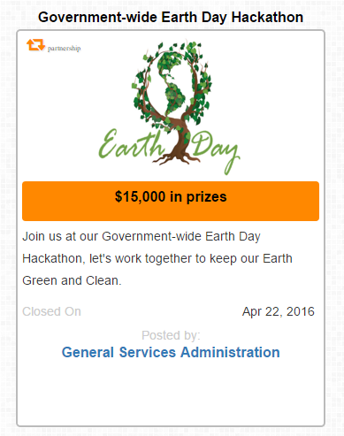
Example
What is an innovation contest?
Innovation contest is the contest where entities raise the innovation-related problems to public agents and reward the best solutions to the problems at the end (Terwiesch & Xu, 2008).
Topic: Keep the Earth Green and Clean
Category: Software/Apps
Posted By: General Services Administration
Partnership With:
Environmental Protection Agency
National Institute of Standards and Technology
Department of Agriculture
etc.
Notes:
<>
Entities: such as: the governments, profit firms or non-profit firms
The contest is also time constraint - It is a 4-weeks contest closed on Apri 22
END
====
(Terwiesch & Xu, 2008)
Introduce what is an innovation contest and its relationship to the public talent and the government…
https://www.challenge.gov/challenge/government-wide-earth-day-hackathon/
From challenge.gov
Registration
Details of Challenge
Data
Prizes
Eligibility
Requirements
Scope

Slide 4
content
Introduction: Open Data and Innovation Contest
Motivation: Practical and Theoretical
Research Question and Research Design
Conceptual Background and Review of Existing Methodologies
Methodologies for This Research
Empirical Examination
Discussion on the Result
Theoretical and Practical Implications
Limitation and Future Work
Content
Notes:
<>
after clarifying the two important concepts in the title
I will now structure my presentation in the following way:
I will motivate my research, practically and theoretically, will present my research question,
then an overview of the literature related to the question, before presenting the mothedology I have developed
Then I will conclude the discussion of the empirical examination, implication, and my work for future research
===
By introducing the background, I will show the motivations of this study and raise the research questions.
Before the methodologies for this research, I will have a literature review on the background and existing methodologies
Then I will conclude my research after the empirical examination with the result discussion, implication and future work
I will introduce
literature review
before
methodology
comclude with emprical ex
and the discussion
===
bullets methodology I developed

Slide 5
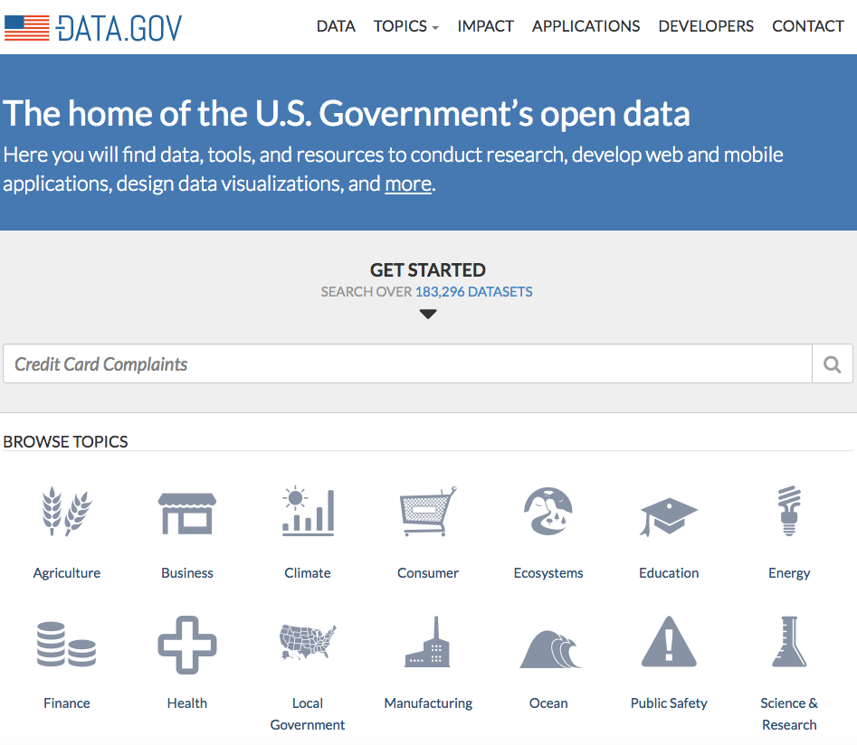
introduction
This time, we will focus on the open data published by the government
Definition
Some data should be freely accessible to the public without restriction in usage and distribution (Geiger & Von Lucke, 2012, p. 185).
Objectives
Improve the public service and create value for the society (Shadbolt et al., 2012).
Help to develop digital innovations (Auer et al., 2007).
Notes:
<>
…
The government are trying to make use of open data as open governmental data to
===
Open data and the public movement (government actions)
Open Data has become foundational for creating digital innovations such as web applications and mashups (Auer et al., 2007).
Open Data is “all stored data of the public sector […] accessible to the public and without restriction in usage and distribution” (Geiger & Von Lucke, 2012, p. 185).
The movement to publish government data is an opportunity to populate the linked data Web with data of good provenance. The benefits range from transparency to public service improvement, citizen engagement to the creation of social and economic value (Shadbolt et al., 2012)

Slide 6
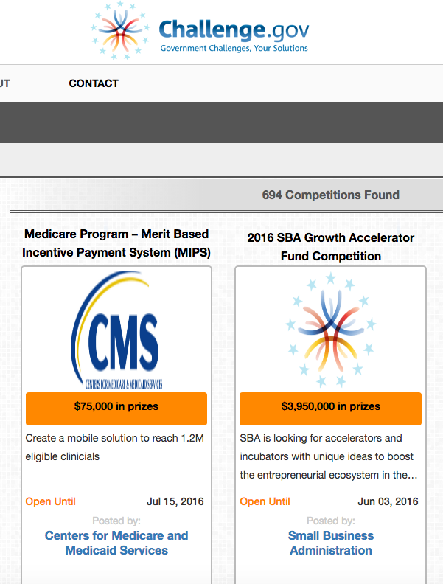
introduction
Governments are also trying to use innovation contests in the area of open data
Innovation contests have become very popular to improve the open data movements (Boudreau et al., 2011).
The documented outcome – Results are mixed for efficiency & innovation (Almirall et al., 2014; Brunswicker & Johnson, 2015)
Problem solving expectations – are not met (Brunswicker & Johnson, 2015)
The contests are not transparent – everyone tries to raise the best solution
Notes:
boom-very popular
blind - not transparent
Currently innovation contest are blind – triger knowledge – greenfield – everyone try the best solution
Another way to reuse – reuse for efficiency but also for novel
There is a boom in innovation contests (such as Challenge.gov) that make use of open data (see Boudreau et al., 2011), to make users innovate by combining multiple datasets.
However, the documented outcome of their problem solving abilities and efficiency has been mixed (Almirall, Lee, & Majchrzak, 2014; Brunswicker & Johnson, 2015)
This ranges from end products (applications) not meeting expectations (low novelty and implementation potential) to simply having low retention rates and productivity.

Slide 7
Practical motivation
practical Practical motivation
Non-transparent contest
Transparent contest
Greenfield
Clone
Creative Reuse
Transparency – a possible solution to create novel and efficient ideas (Nickerson, 2015).
Transparency -> Reuse -> “cloned” &“creative reuse” (Nickerson, 2015).
Notes:
<>
There are three kinds of solutions for open data: “greenfield”, “cloned” and “creative reuse” (Girotra et al., 2010).
====
define transparency
remove right part
Organizers and researchers are eager to learn the reuse behavior and identify the novel project in contests
Currently innovation contest are blind – triger knowledge – greenfield – everyone try the best solution
Another way to reuse – reuse for efficiency but also for novel
Current innovation contest
How to identify copy and reuse in new context
The development for open data, has 3 types: Green – 2 – 3
Current innovation contest design only for 1
How to support 2,3
===
Literature on innovation contests points to transparency as a possible solution to the “novelty/reuse” problematic.
Seeing the performance of others may create incentives effects for creating novel “greenfield” ideas (see Girotra et al., 2010)
Seeing the solutions of others may trigger remixing of others’ solutions to create new novel ideas (Nickerson, 2015).
but wait – I could just copy the ideas of others??? (herding, blatant copying) Or, even better, I’ll just use this solution’s idea, because hey! I can see from her performance scores that she’s number 1, so I’ll just use this idea and work from it (idea fixation)”
By measuring the reuse, researchers/organizers are able to learn the reuse behaviors of participants, trigger better solutions by contest setting
====
innovation
transpareny
..
no trans VS trans -> trigers to result
bridge the points
motivation - video? - measure ? ExCEO of microsoft
no transparency
practical -> theoretical

Slide 8
Practical motivation
practical Practical motivation
Non-transparent contest
Transparent contest
Greenfield
Clone
Creative Reuse
Transparency – a possible solution to create novel and efficient ideas (Nickerson, 2015).
Transparency -> Reuse -> “cloned” &“creative reuse” (Nickerson, 2015).
How to identify?
Notes:
<>
There are three kinds of solutions for open data: “greenfield”, “cloned” and “creative reuse” (Girotra et al., 2010).
====
define transparency
remove right part
Organizers and researchers are eager to learn the reuse behavior and identify the novel project in contests
Currently innovation contest are blind – triger knowledge – greenfield – everyone try the best solution
Another way to reuse – reuse for efficiency but also for novel
Current innovation contest
How to identify copy and reuse in new context
The development for open data, has 3 types: Green – 2 – 3
Current innovation contest design only for 1
How to support 2,3
===
Literature on innovation contests points to transparency as a possible solution to the “novelty/reuse” problematic.
Seeing the performance of others may create incentives effects for creating novel “greenfield” ideas (see Girotra et al., 2010)
Seeing the solutions of others may trigger remixing of others’ solutions to create new novel ideas (Nickerson, 2015).
but wait – I could just copy the ideas of others??? (herding, blatant copying) Or, even better, I’ll just use this solution’s idea, because hey! I can see from her performance scores that she’s number 1, so I’ll just use this idea and work from it (idea fixation)”
By measuring the reuse, researchers/organizers are able to learn the reuse behaviors of participants, trigger better solutions by contest setting
====
innovation
transpareny
..
no trans VS trans -> trigers to result
bridge the points
motivation - video? - measure ? ExCEO of microsoft
no transparency
practical -> theoretical

Slide 9
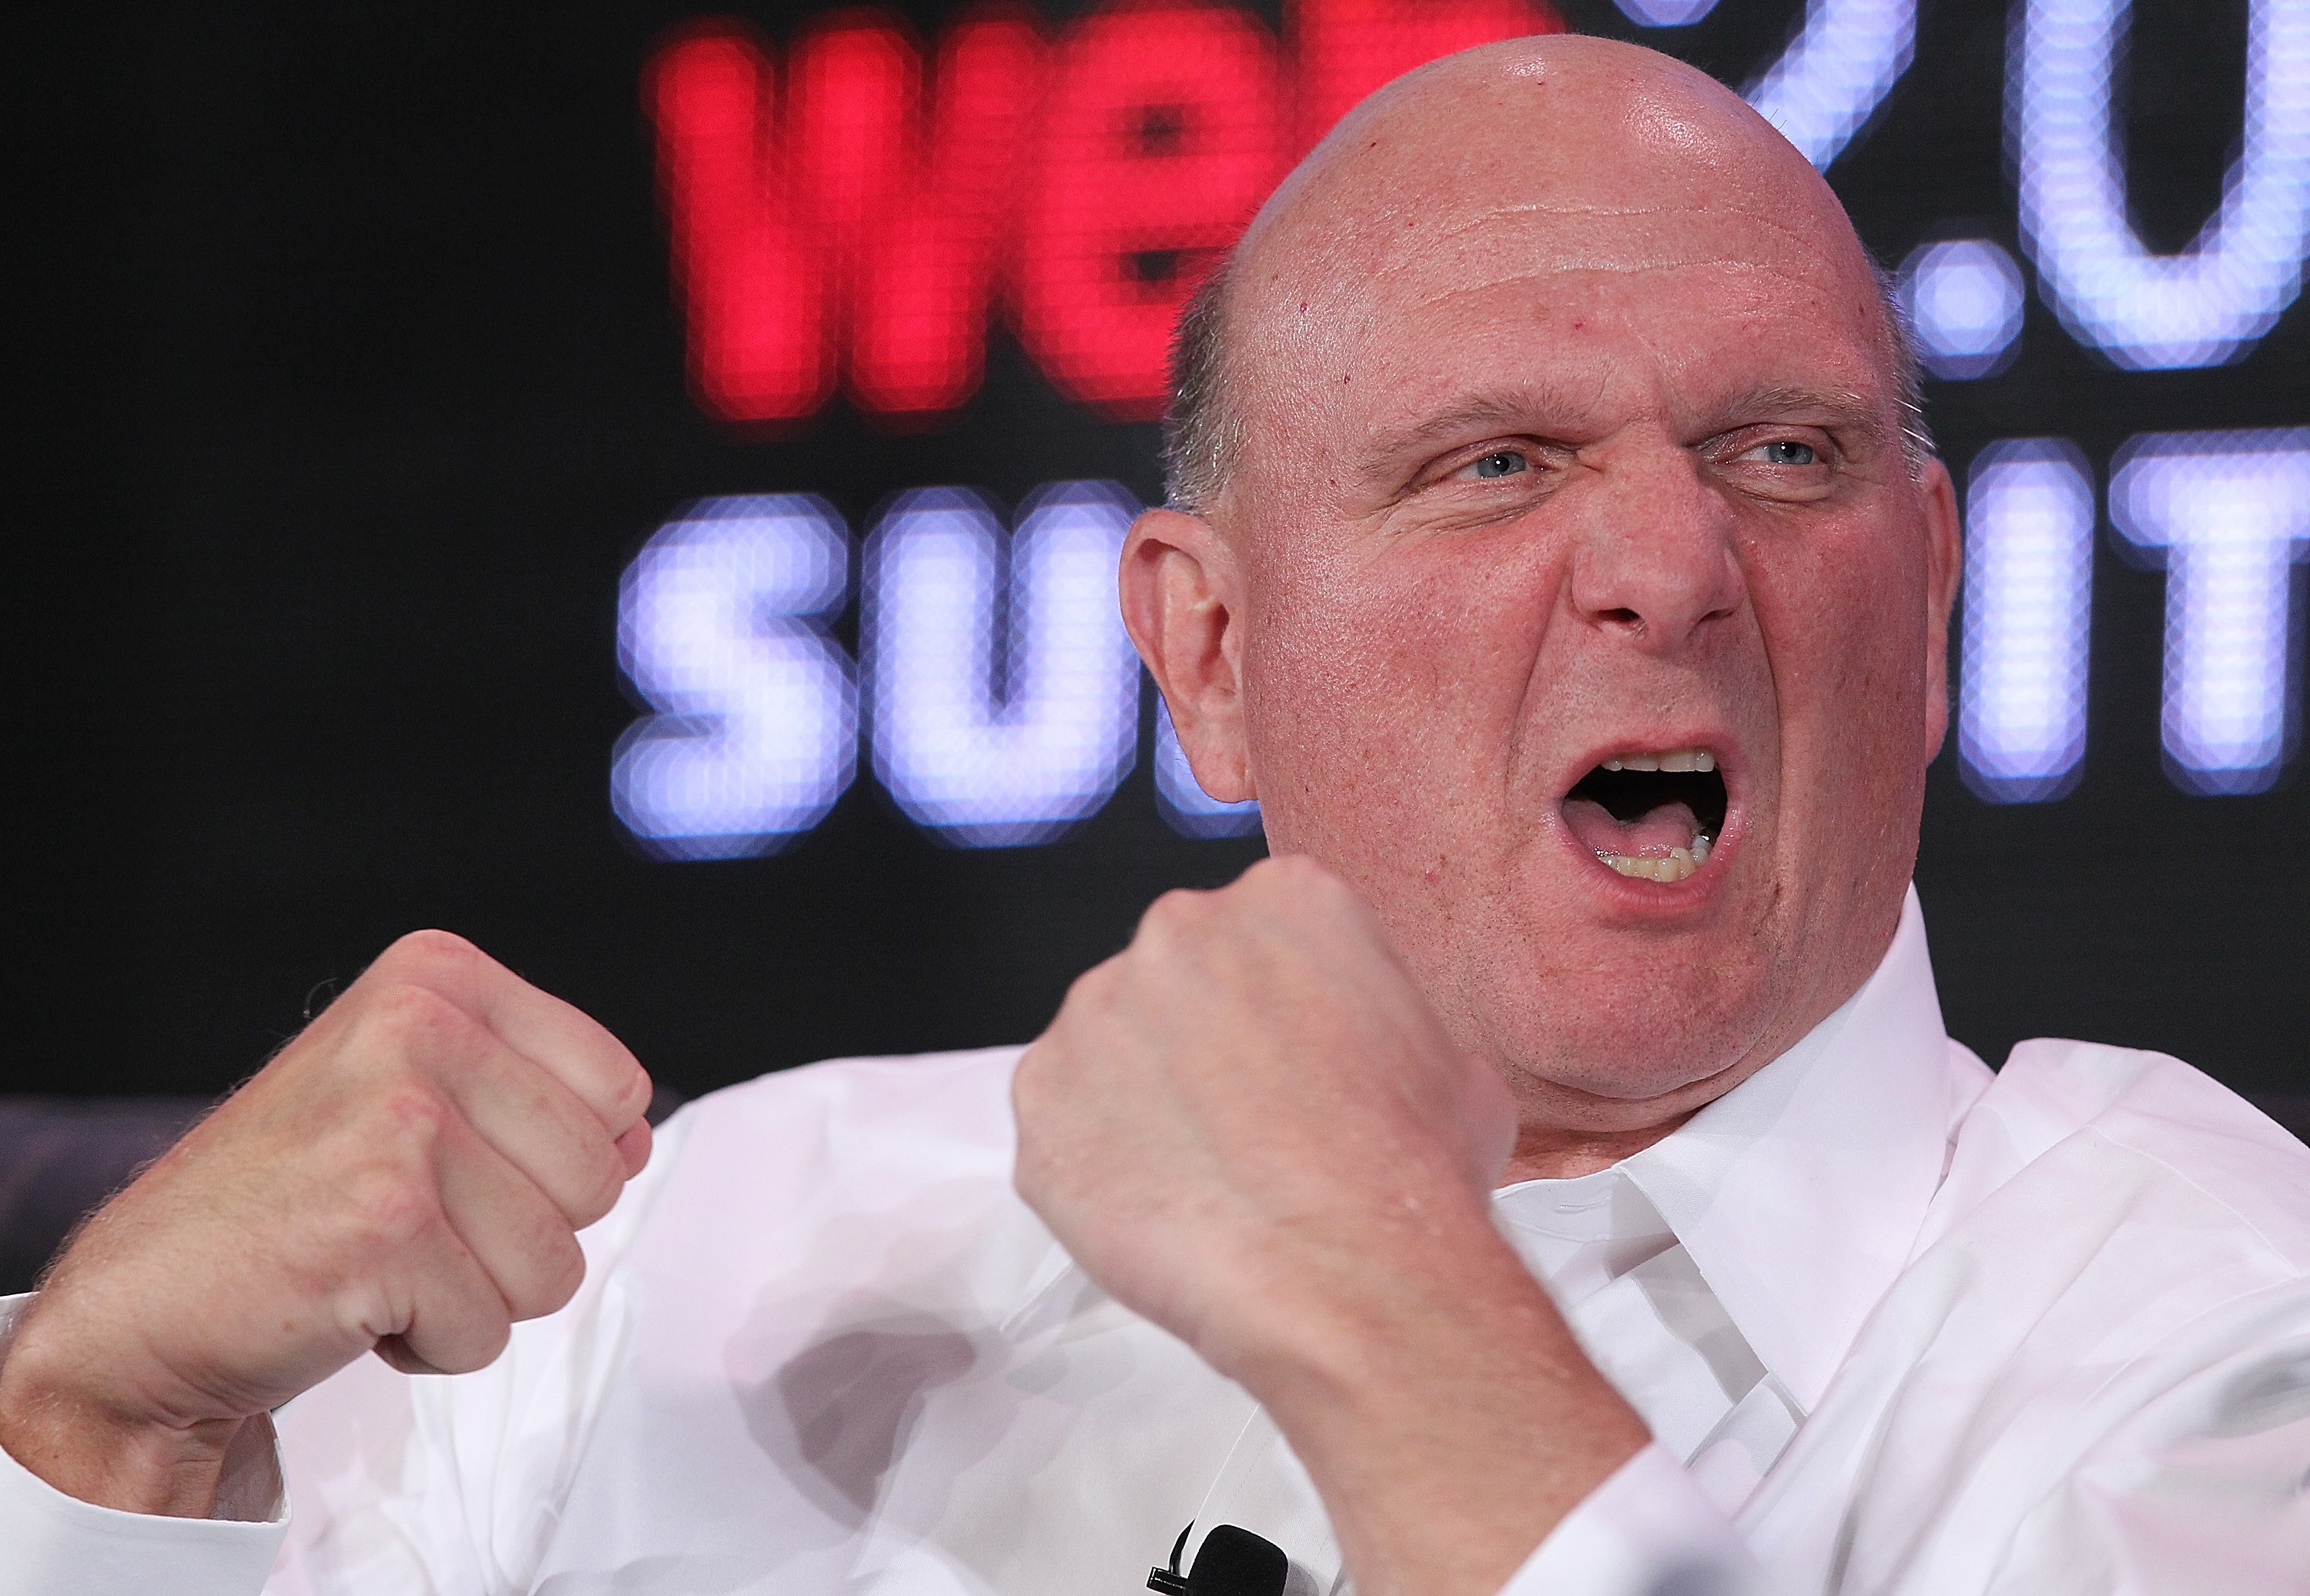
Measure!
Practical motivation
Measure!
Measure!
Notes:
Steve Ballmer
Ex CEO of MS, measure everything you want to learn or explain!

Slide 10
Practical motivation
Similarity
Notes:
Similarity is used to measure the level and result of reuse

Slide 11
Theoretical motivation
When we go to the existing literature of similarity . . .
There has been a lot of work on the conceptualization of similarity in different types of software – but none of them is defined for mashup application
So what could be the difference for a mashup?
Notes:
go back to exsiting literatures for similarity
Script:
For example, the image similarity – how similar do they look like? Computational approach – measure the position of pixels
===
Your focus is on conceptualization of similiarty of mash-ups which are developed without the existence of standards, and have multiple layer
Current in cs has developed methods on code… they could not be transfered to open data, contests
Psychology also has... But only conceptual, not translated to computational
Show the mashup layers
Transparency modification - different approaches - theoretical similarity - what they have done
identify what I am going to do -> how to improve it
1 - theoretical motivation
->how they are different ->mashup
why best/not
many measures -> not for mashups -> three dimensions

Slide 12
Theoretical motivation
Let’s come back to this mashup example
Notes:
Introduce what is a mashup and the basic components and characteristics of a mashup
Hoyer, V., Stanoesvka-Slabeva, K., Janner, T., & Schroth, C. (2008). Enterprise Mashups: Design Principles towards the Long Tail of User Needs. In IEEE International Conference on Services Computing, 2008. SCC ’08 (Vol. 2, pp. 601–602). http://doi.org/10.1109/SCC.2008.88

Slide 13
Theoretical motivation
We can learn the difference from the example
Traditional Software
Similar functions in same page
Less data interaction
Specific end-users
COMPARE
Mashup
Functions diverse in different components
More data interaction
Diverse end-users
Notes:
Your focus is on conceptualization of similiarty of mash-ups which are developed without the existence of standards, and have multiple layer
Current in cs has developed methods on code… they could not be transfered to open data, contests
Psychology also has... But only conceptual, not translated to computational
Show the mashup layers
Transparency modification - different approaches - theoretical similarity - what they have done
identify what I am going to do -> how to improve it
1 - theoretical motivation
->how they are different ->mashup
why best/not
many measures -> not for mashups -> three dimensions
=====
Current in cs has developed methods on code… they are transparable to open data, contests
Psychology also has... But only conceptual, not translated to computational
Show the mashup layers
===
Why not deep learning? – should focus on end-user
research gap: current approaches to measure - they are not good enough
code
function
===
Although there are multiple ways to find similarities among different enterprise softwares (Yamamoto et al., 2005)
None of current approaches are developed to deal with the specific code similarity in the context of an open data contest (Cosma & Joy, 2012).
More research is needed to address the similarity measurements in different dimensions for mash-ups. There are three dimensions: code, functionality feature and visualized feature (Edberg et al., 2012).

Slide 14
Theoretical motivation
There are some existing gaps in this research area
The conceptualization of similarity of mashup - no existing standard
Existing similarity measurements are designed for traditional softwares
Methods for code similarity in the CS – not developed for open data mashups
Methods for software feature similarity in psychology – only conceptual and subjective
Deep learning methods for function similarity in CS – not focusing the end users
My theoretical motivation is to overcome these research gaps.
Notes:
Your focus is on conceptualization of similiarty of mash-ups which are developed without the existence of standards, and have multiple layer
Current in cs has developed methods on code… they could not be transfered to open data, contests
Psychology also has... But only conceptual, not translated to computational
Show the mashup layers
Transparency modification - different approaches - theoretical similarity - what they have done
identify what I am going to do -> how to improve it
1 - theoretical motivation
->how they are different ->mashup
why best/not
many measures -> not for mashups -> three dimensions
=====
Current in cs has developed methods on code… they are transparable to open data, contests
Psychology also has... But only conceptual, not translated to computational
Show the mashup layers
===
Why not deep learning? – should focus on end-user
research gap: current approaches to measure - they are not good enough
code
function
===
Although there are multiple ways to find similarities among different enterprise softwares (Yamamoto et al., 2005)
None of current approaches are developed to deal with the specific code similarity in the context of an open data contest (Cosma & Joy, 2012).
More research is needed to address the similarity measurements in different dimensions for mash-ups. There are three dimensions: code, functionality feature and visualized feature (Edberg et al., 2012).

Slide 15
Research question
So there are two research questions for my thesis
Q1: How can similarity be conceptualized for mash-ups developed in transparent open data contests?
Q2: How can similarity be computationally measured for mash-ups developed in transparent open data contests?

Slide 16
Research design
There are three dimensions in mashup evaluation
The evaluation of software mashups could be separated in to three different dimensions (Rodriguez & Chinea, 1998):
Technology (code)
Functional Feature
Visualized Feature
End User Decision
Enable
Support
Functional Feature
Visualized Feature
Develop
Technology (code)
Notes:
Amabile in creativity measure
Complimentary factors

Slide 17
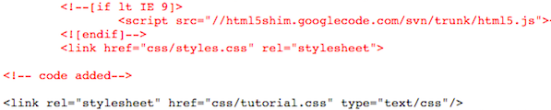
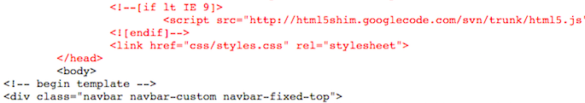
Research design
An example for code comparison
The evaluation of software mashups could be separated in to three different dimensions (Rodriguez & Chinea, 1998):
Technology (code)
How similar they are in the “code” level (Addy et al., 1999)
VS

Slide 18
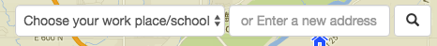
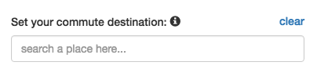
Research design
An example for functional feature comparison
The evaluation of software mashups could be separated in to three different dimensions (Rodriguez & Chinea, 1998):
Functional Feature
How similar are the features (Tversky, 1977). It plays an important role in the research of knowledge and behavior.
VS

Slide 19
Research design
A specific scope is defined for this research
The study is in the context of open data innovation contest.
Function is the key of a mashup development (Yu, Benatallah, Casati, & Daniel, 2008) - This study will focus on the first two dimensions: code & functional feature.
Programming languages and external libraries (resources) should be restricted.
Notes:
Why only fucntional not visual?
Function is most important part for mashup
Code triger reuse originally – code could affect real function
(Yu, Benatallah, Casati, & Daniel, 2008)
Process a meta-analysis on the code similarity to find the fundamental concepts of code similarity for mash-ups in open data contest.
Use existing public service to process the code similarity measurement based on the relative literature review.
Design algorithm to match the similar parameters in the source code for functionality features. Apply test case method to ensure the validity of the functionlity feature similarity measurement.

Slide 20
Research design
In this research, I will
Use a process model from Design Science (March & Smith, 1995):
1
Literature Review on Code Similarity & Functional Feature Similarity
2
Develop Measurement Algorithm
3
Experiment Based on the Collected Data
4
Evaluation of the Design
Notes:
(March & Smith, 1995)
March, S. T., & Smith, G. F. (1995). Design and natural science research on information technology. Decision Support Systems, 15(4),
Process a meta-analysis on the code similarity to find the fundamental concepts of code similarity for mash-ups in open data contest.
Use existing public service to process the code similarity measurement based on the relative literature review.
Design algorithm to match the similar parameters in the source code for functionality features. Apply test case method to ensure the validity of the functionlity feature similarity measurement.

Slide 21
Research design
In order to test the validity for this research
Internal Validity
Validity of the computational methods:
Code Similarity: use existing tested methods to complete the computation – find the best one for mashup.
Functional Feature Similarity: use “test case” approach to ensure validity (Nebut et al., 2006).
External Validity
The methods are tested in two different open data innovation contests:
2015 BlueIronhack: 10 * 3 = 30 collected projects.
2016 GreenIronhack: 26 * 4 = 104 collected projects.
There are limitations to the external validity according to the programming languages and external libraries.
Notes:
Process a meta-analysis on the code similarity to find the fundamental concepts of code similarity for mash-ups in open data contest.
Use existing public service to process the code similarity measurement based on the relative literature review.
Design algorithm to match the similar parameters in the source code for functionality features. Apply test case method to ensure the validity of the functionlity feature similarity measurement.

Slide 22
Literature review
There are multiple ways to measure code similarity
Technology (code)
Find how similar they are in the “code” level
Lexical approach to measure the exact same syntactic style of “tokens” and “strings” in the code (Baker, 1995)
Semantic approach to figure out the “meaning” of words and sentences
Abstracted graph approach to find out the structures of the code (Baxter & Yahin, 1998)
Other techniques: subjective supervising, machine learning (Basit & Jarzabek, 2009), etc.

Slide 23
Literature review
There are multiple ways to measure functional feature similarity
Functional Feature
Ontology Components: Finding out all the components would be helpful to evaluate a software application (Beydoun, Low, García-Sánchez, Valencia-García, & Martínez-Béjar, 2014).
Scenario-Based Parameters: By going through a scenario of using the application, we could find all the parameters that influencing the function for users.
Cluster: Components and parameters could be separated in different clusters (higher-level ontology components), which support specific user-end functions (Nikerson & Corter, 2008).
Decision Support System: functional feature could also be defined based on the equally-weighted parameters (scenario-based parameters) provided in the system (Özacar, 2016)

Slide 24
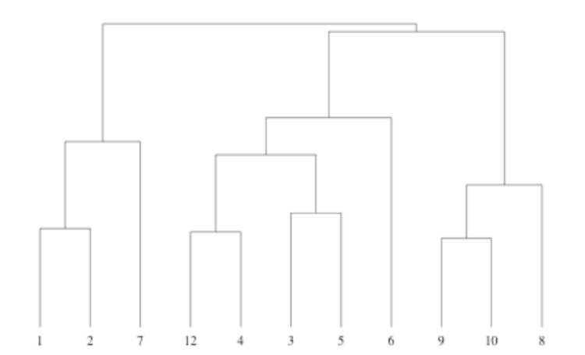
Literature review
A prototype for cluster approach for end-user functions
Figure1: Prototype for cluster approach for end-user functions(Nikerson & Corter, 2008)

Slide 25
methodology
After doing a meta-analysis on code similarity
Type | Syntactic | Semantic | High Efficiency | High Accuracy | Need Human Support | Work for Large Scale | Need pre-requirements
String Structure | No | Yes | Yes | No | Yes | Yes | No
Token Structure | No | Yes | Yes | No | No | Yes | No
Abstract Tree (Graph) Structure | Yes | No | No | Yes | No | No | No
Metric Based | Yes | No | No | No | No | No | No
Machine Learning | Yes | Yes | No | Yes | Yes | Yes | Yes
Mashup | Yes | Yes | Yes | Yes | No | No | No
Table 1 Characteristics for different code similarity measurement approaches
Notes:
Co
How to pick up the methods
color
reference in each cell

Slide 26
methodology
After doing a meta-analysis on code similarity
Type | Syntactic | Semantic | High Efficiency | High Accuracy | Need Human Support | Work for Large Scale | Need pre-requirements
String Structure | No | Yes | Yes | No | Yes | Yes | No
Token Structure | No | Yes | Yes | No | No | Yes | No
Abstract Tree (Graph) Structure | Yes | No | No | Yes | No | No | No
Metric Based | Yes | No | No | No | No | No | No
Machine Learning | Yes | Yes | No | Yes | Yes | Yes | Yes
Mashup | Yes | Yes | Yes | Yes | No | No | No
Table 1 Characteristics for different code similarity measurement approaches
Notes:
How to pick up the methods
color
reference in each cell

Slide 27
methodology
I compare several different code clone detections tools and find out
Name | Structual | Lexical | Javascript/HTML
MOSS | Y | Y | Y
PDetect | Y | Y | N
SID | N | N | N
TEAMHANDIN | Y | N | N
Jones | N | Y | N
Table 2 Characteristics for different code clone detection tools
Notes:
(Schleimer, Wilkerson, & Aiken, 2003)

Slide 28
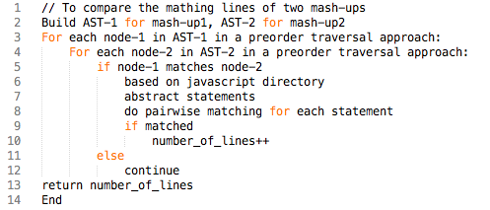
methodology
How does MOSs system process two projects
Figure 2 Psuedocode for code similarity measurement in MOSS
Notes:
Baxter and Yahin (1998)

Slide 29
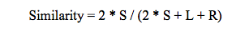
methodology
The formula I use to calculate code similarity
(Baxter & Yahin, 1998)
S: Number of shared lines of code
L: Number of different lines of code in the first project
R: Number of different lines of code in the second project
Notes:
In lines
Baxter and Yahin (1998)

Slide 30
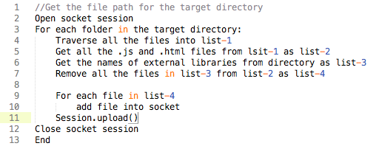
methodology
Before submitting, the source code should be washed
Figure 3 Psuedocode for data washing
Notes:
Baxter and Yahin (1998)

Slide 31
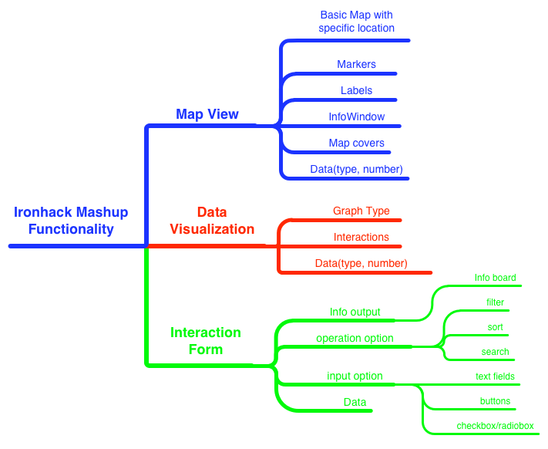
methodology
Use components and parameters to define end-user functions
Figure 4 Components and parameters in decision support system (Guo, J., & Tokuda, T., 2010).

Slide 32
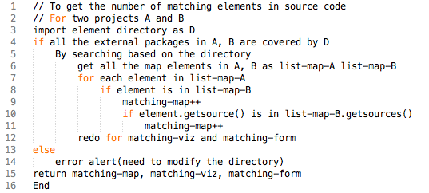
methodology
As for the algorithm designed to detect functional feature parameters
Figure 5 Psuedocode for functional feature similarity measurement
Notes:
Baxter and Yahin (1998)

Slide 33
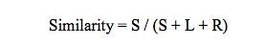
methodology
The formula I use to calculate functional feature similarity
Tversky similarity with Jaccard Index:
S: Number of shared parameters in the source code
L: Number of different parameters in the first project
R: Number of different parameters in the second project
Notes:
Jaccard index measuring similarity for two sets with finite parameters

Slide 34
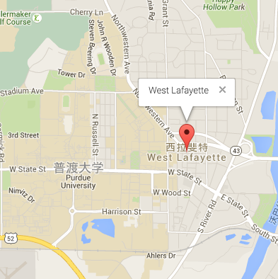
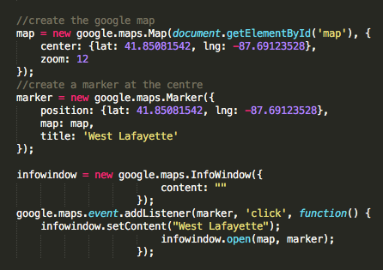
methodology
Example – functionality feature similarity

Slide 35
methodology
Example – functionality feature similarity

Slide 36
methodology
Example – functionality feature similarity

Slide 37
methodology
Example – functionality feature similarity

Slide 38
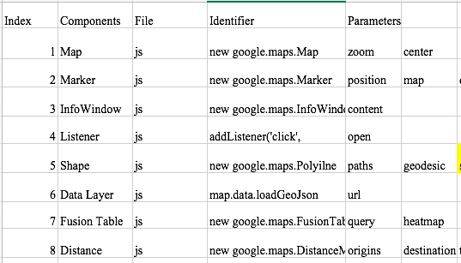
methodology
Dictionary for functional similarity – Google map api example

Slide 39
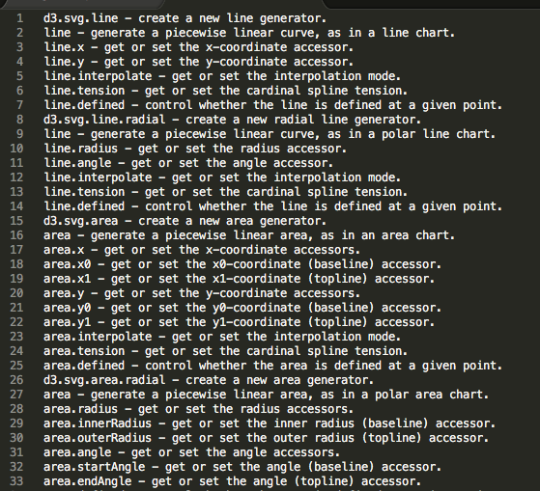
methodology
Dictionary for functional similarity – d3 example

Slide 40
methodology
Dictionary for functional similarity – Test cases
Test Case | Desctiption | Designed Parameters | Detected Parameters
1 | map | 25 | 25
2 | sigma | 9 | 9
3 | arbor | 13 | 13
4 | d3 | 200 | 200
5 | layouts | 15 | 15
6 | library layouts | 200 | 200
7 | viz combination | 220 | 220
8 | map combination | 33 | 33
9 | layout combination | 300 | 300
10 | overall combination | 400 | 400
Table 3 Test cases for functional similarity method

Slide 41
Empirical examination
I have two examinations in this research . . .
Examination 1:
2015 Purdue BlueIronhack
10 * 3 = 30 mashup projects
Examination 2:
2016 Purdue GreenIronhack
26 * 4 = 104 mashup projects
There are required to use JavaScript and HTML as major language
Google Map API is required
One of the three data visualization libraries is suggested
Notes:
Use feature - code

Slide 42
Empirical examination
Examination 1 – pilot test on code similarity
Notes:
Use feature -
code
histogram

Slide 43
Empirical examination
Examination 1 – pilot test on functional feature similarity
Notes:
Use feature - code

Slide 44
Empirical examination
Examination 2 – code similarity
Max Point: ishwetasingh & jeffkeilmann 0.38
Notes:
Histegram
Low
High as example

Slide 45
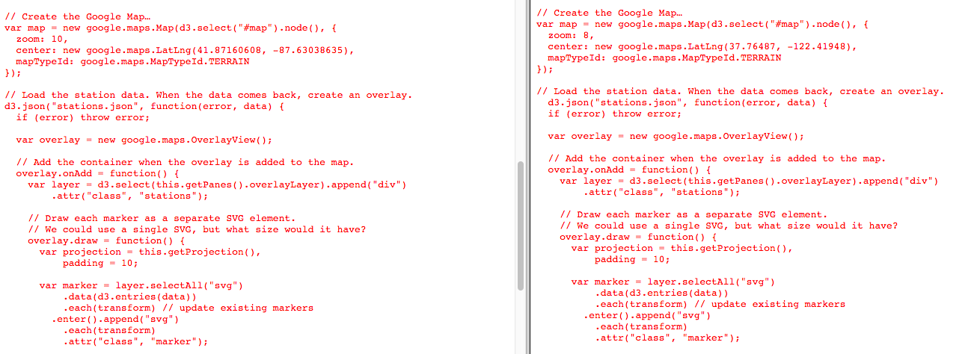
Empirical examination
How are they similar in code level
Notes:
Histegram
Low
High as example

Slide 46
Empirical examination
Examination 2 – functional feature similarity
Max Point: ishwetasingh & jeffkeilmann 0.32
Notes:
Histegram
Low
High as example

Slide 47
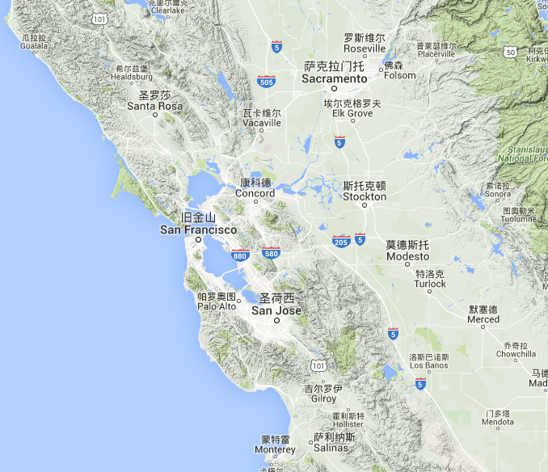
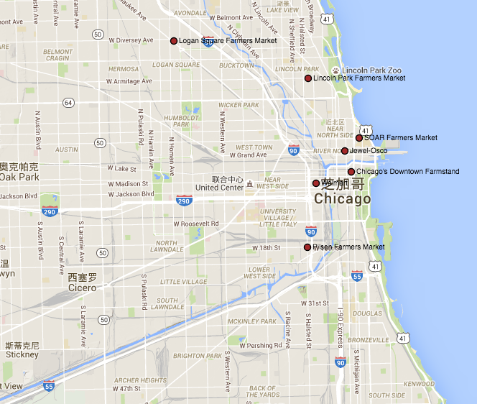
Empirical examination
How are they similar in functional feature level
Code similarity: 0.38
Functional feature similarity: 0.32
Notes:
Histegram
Low
High as example

Slide 48
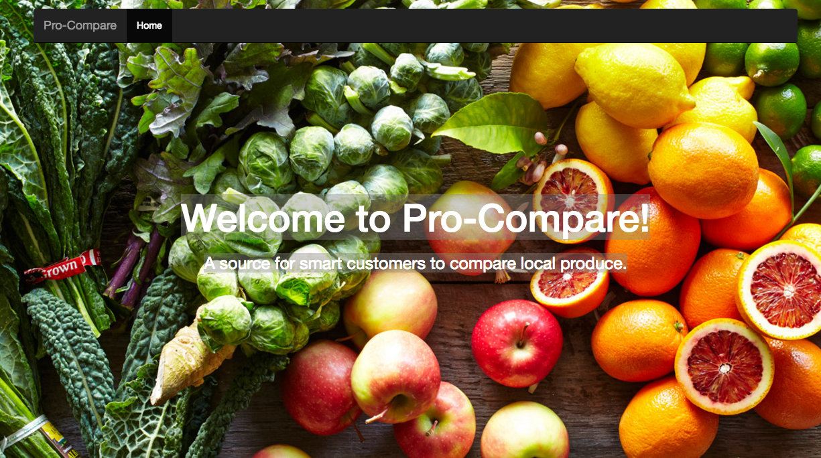
Empirical examination
Another example with low similarity scores with the previous two
Notes:
Histegram
Low
High as example

Slide 49
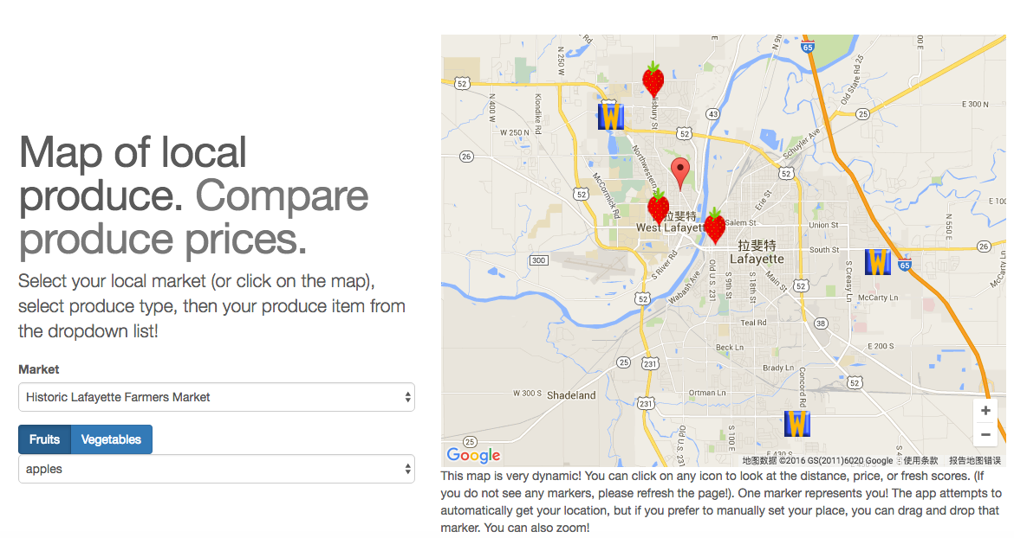
Empirical examination
End-user functions and google map
Notes:
Histegram
Low
High as example

Slide 50
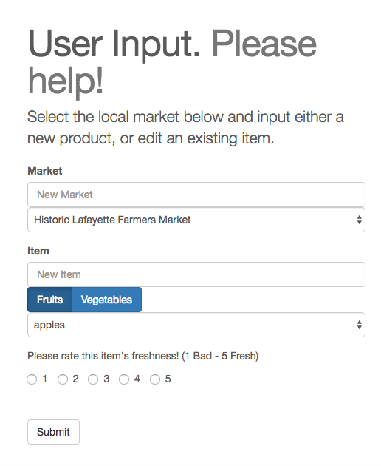
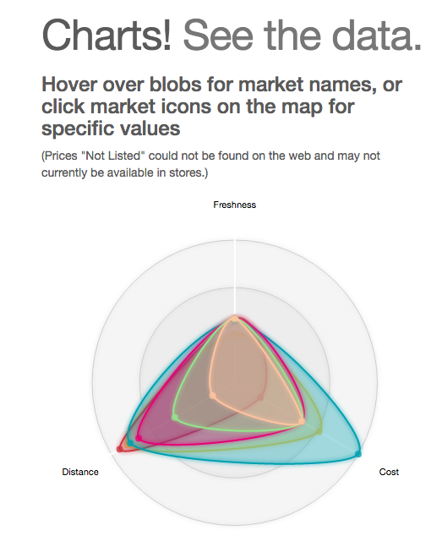
Empirical examination
Data visualization and user interaction
Notes:
Histegram
Low
High as example

Slide 51
Future implications
There are theoretical and practical implications
Theoretical Implications:
Extend current literature on the conceptualization of similarity for mashups.
Find the suitable code similarity measurement method for mashups.
Design the computational method for functional feature similarity measurement.
Practical Implications:
Support the “reuse” measurement in transparent open data contest.
Notes:
Use feature - code

Slide 52
limitations
There are several limitations in this research
“Similarity” might not be sufficient to measure “reuse” in some situations.
The study is focusing on two of the three levels of mashup dimensions, which are code similarity and functional feature similarity.
This study has scalability to the open data contests with limited programming languages and libraries.
More researches have to be done to ensure the generalizability of this study. Currently only the 134 projects in Purdue Ironhacks are measured

Slide 53
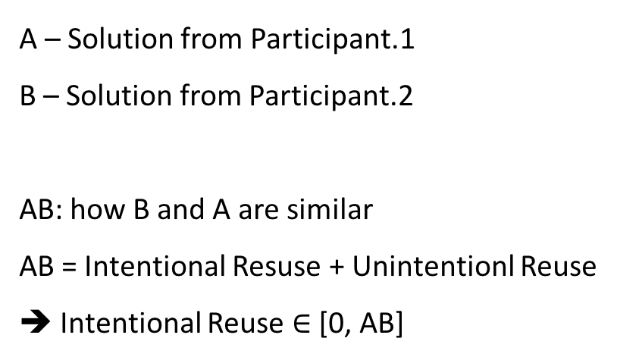
Future research
For the future work I can do based on this research
Visualized feature similarity
Learn the relationship between different dimensions
Counting the “real reuse”
A – Solution from Participant.1
B – Solution from Participant.2
AB: how B and A are similar
AB = Intentional Resuse + Unintentionl Reuse
➔ Intentional Reuse $∈$ [0, AB]
A
AB
B
B
B
Notes:
how to define the innvation?

Slide 54
Thank you
MEASURING MASHUP SIMILARITY
IN OPEN DATA CONTESTS

